Slide 1

Heat and Thermodynamics
Kinde Yeneayehu
June, 2022
ASTU
ASTU
Cover Page - 1/49
June - 2022

Slide 2
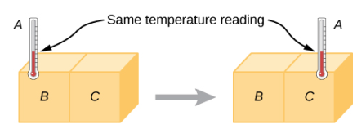
The Concept of Temperature and the Zeroth law of Thermodynamics
If object A is in thermal equilibrium with object B, and object B is in thermal equilibrium with object C, then object A is in thermal equilibrium with object C. That statement of transitivity is called the zeroth law of thermodynamics.
A
B
B
C
Then temp of A equal to temp C is known as zero law of thermodynamics
ASTU
The concept of Temperature - 2/49
June - 2022

Slide 3
The Concept of (Cont’d)
When the physical properties are no longer changing, the objects are said to be in thermal equilibrium.
Two or more objects in thermal equilibrium have the same temperature.
If two objects are in contact with one another long enough, the two objects have the same temperature.
This is the zeroth law of thermodynamics.
ASTU
The concept of Temperature - 3/49
June - 2022

Slide 4
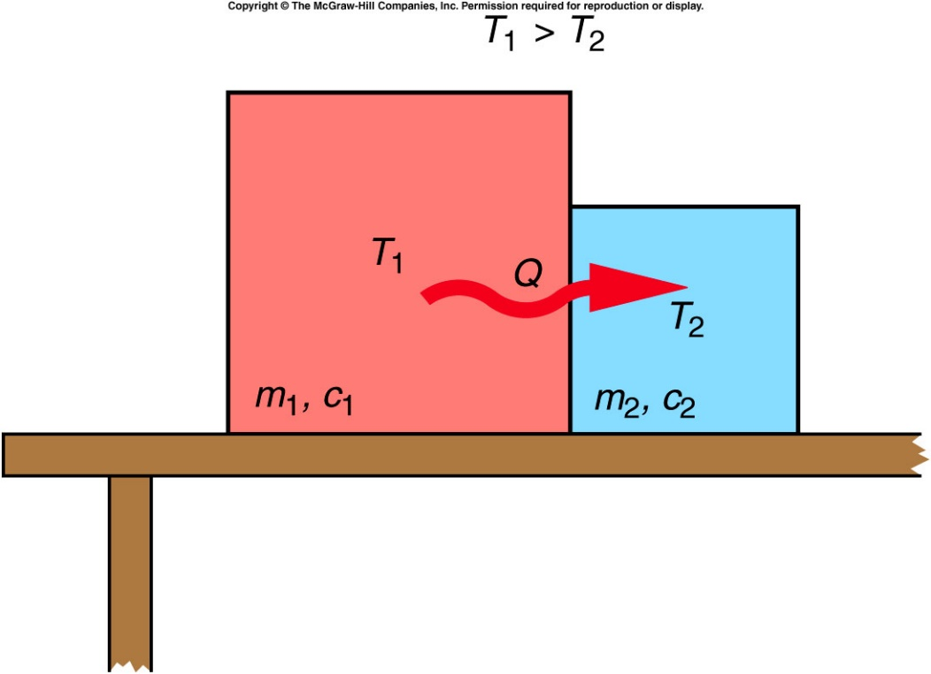
The Concept of (Cont’d)
When two objects at different temperatures are placed in contact, heat will flow from the object with the higher temperature to the object with the lower temperature.
Heat added increases temperature, and heat removed decreases temperature.
Heat and temperature are not the same.
Temperature is a quantity that tells us
which direction the heat will flow.
ASTU
The concept of Temperature - 4/49
June - 2022

Slide 5
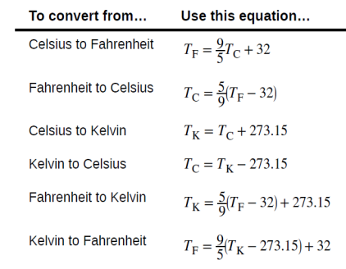
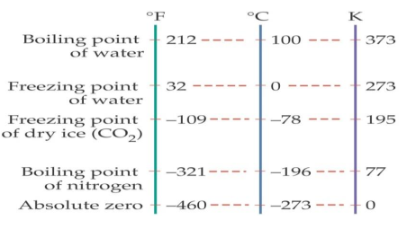
The Concept of (Cont’d)
Temperature Scales
Thermometers measure temperature
The three most common temperature scales are Fahrenheit, Celsius, and Kelvin.
Relationships between the Fahrenheit, Celsius, and Kelvin
ASTU
The concept of Temperature - 5/49
June - 2022

Slide 6
Thermal Expansion
Thermal Expansion
Linear Thermal Expansion
Areal Expansion
Volume Expansion
$$Δl=αl_{o}ΔT ⇒l=l_{o}\left(1+αΔT\right), α=\frac{l_{o}}{Δl}ΔT ;has units K^{−1} and ({ ℃}^{−1})$$
ASTU
Thermal Expansion - 6/49
June - 2022

Slide 7
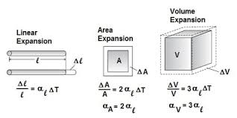
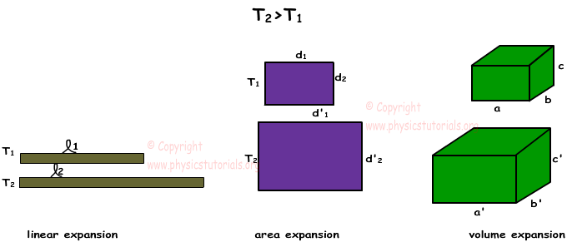
Thermal Expansion(cont’d)
ASTU
Thermal Expansion - 7/49
June - 2022

Slide 8
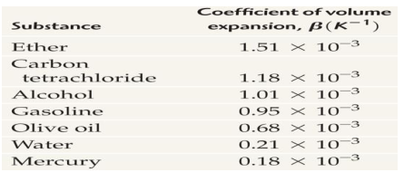
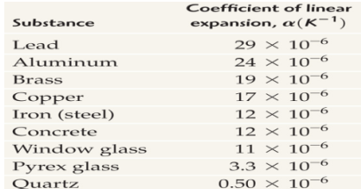
Thermal Expansion(cont’d)
ASTU
Thermal Expansion - 8/49
June - 2022

Slide 9
The Concept of Heat, Work and Internal Energy
Heat, Q and unit Joule (J), is the spontaneous flow of energy into or out of a system caused by a difference in temperature between the system and its surroundings, or between two objects whose temperatures are different.
Work, W and unit Joule (J), is a non-spontaneous energy transfer into or out of a system due to force acting through a displacement.
Heat and work are two possible ways of transferring energy from one system to another
ASTU
The Concept of Heat, Work and Internal Energy - 9/49
June - 2022

Slide 10
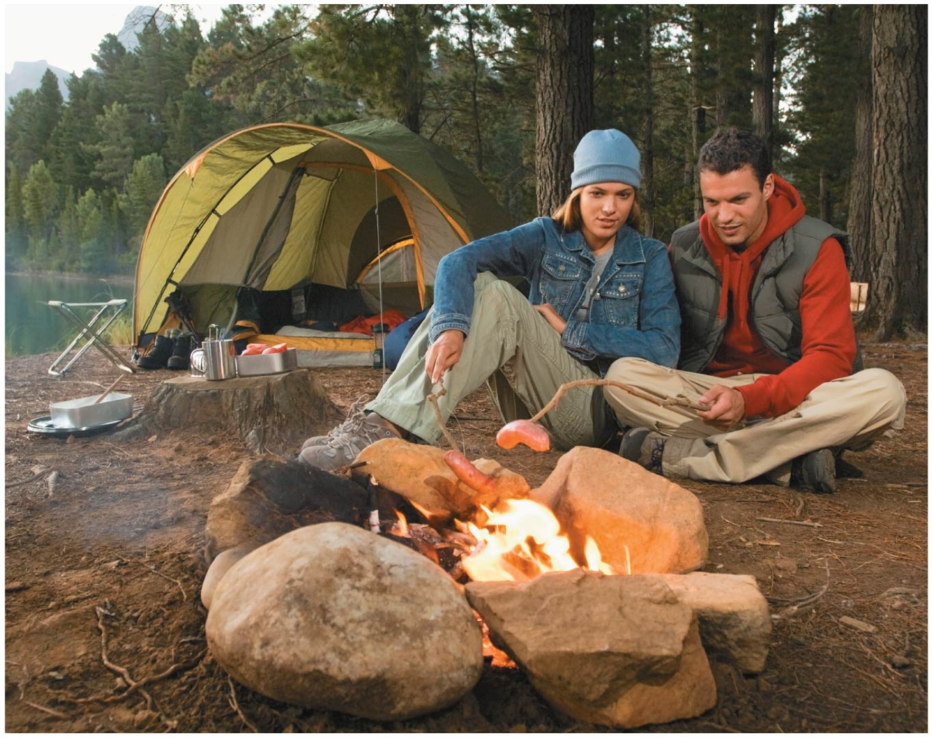
The Concept of Heat, Work and Internal Energy
Heat is a form of energy that can be transferred from one system to another as a result of temperature difference.
The science that deals with the determination of the rates of such energy transfer is heat transfer.
ASTU
The Concept of Heat, Work and Internal Energy - 10/49
June - 2022

Slide 11
The Concept of Heat, Work and Internal Energy
Internal Energy, U, is defined as the energy associated with the random, disordered motion of the microscopic components-atoms and molecules.
Any bulk kinetic energy of the system due to its motion through space is not included in its internal energy.
Internal energy includes kinetic energy of translation, rotation, and vibration of molecules,
NB. Internal energy changes can also occur in the absence of temperature changes
ASTU
The Concept of Heat, Work and Internal Energy - 11/49
June - 2022

Slide 12

The Concept of Heat(Cont’d)
Matter is made up of moving particles (molecules, atoms, and ions).
Heat is the flow of energy from hotter region to the cooler region.
$$Q=ΣE_{k}+ΣU$$
When the substance heat up, two things could happen;
The particles of the substance gain kinetic energy and so move more rapidly.
The bonds between the particles in the substance are broken and the potential energy of the substances increases. When this happens, the substances changes state.
ASTU
The Concept of Heat, Work and Internal Energy - 12/49
June - 2022

Slide 13
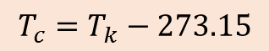
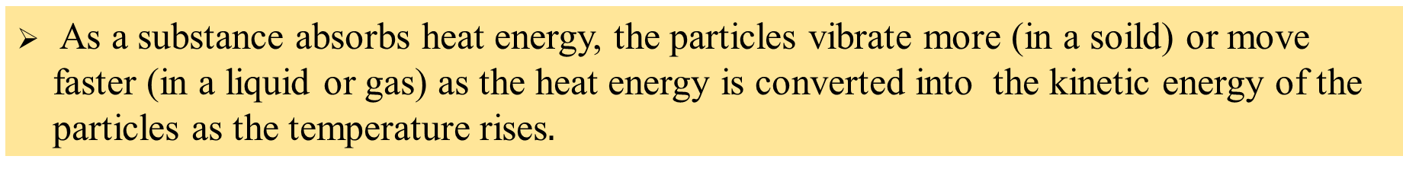
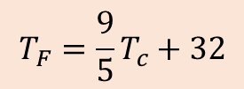
The Concept of Heat(Cont’d)
Temperature is a measure of hotness and coldness of a substance. The temperature of a substance is a measurement of the average kinetic energy of the particles within the substance.
$$T_{c}=T_{k}−273.15$$
$$T_{F}=\frac{9}{5}T_{c}+32$$
As a substance absorbs heat energy, the particles vibrate more (in a soild) or move faster (in a liquid or gas) as the heat energy is converted into the kinetic energy of the particles as the temperature rises$.$
ASTU
The Concept of Heat, Work and Internal Energy - 13/49
June - 2022

Slide 14

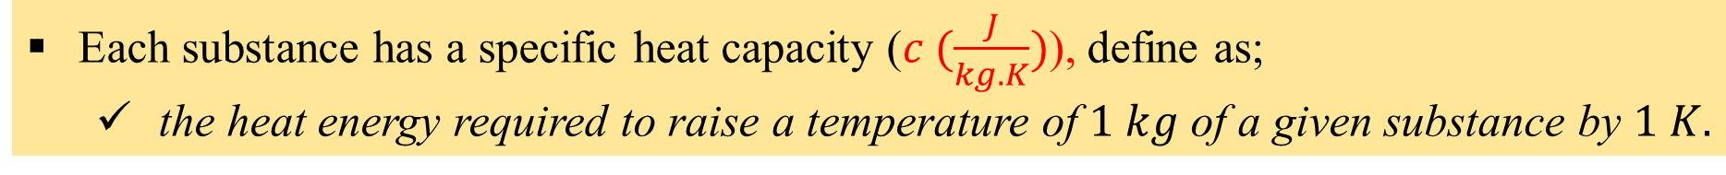
Specific Heat and Latent Heat
The calorie ($cal$) is defined as the energy necessary to raise the temperature of 1 g of water by $1℃$.
$$1 cal=4.186 J$$
The amount of heat energy required to raise temperature depend on;
Typed of substance being heated.
The amount of substance (mass)
Temperature
Each substance has a specific heat capacity ($c (\frac{J}{kg.K})$), define as;
the heat energy required to raise a temperature of $1 kg$ of a given substance by $1 K.$
ASTU
Specific Heat and Latent Heat - 14/49
June - 2022

Slide 15

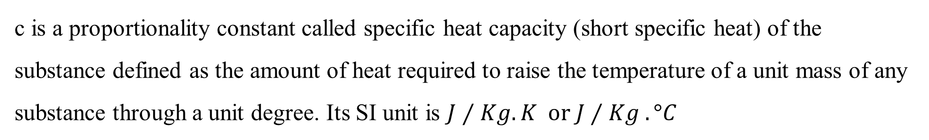
Specific Heat and Latent Heat (Cont’d)
Specific Heats:
The quantity of heat, Q, required to change the temperature of a body of mass m by ΔT is proportional to both the mass and the change in temperature. Mathematically,
c is a proportionality constant called specific heat capacity (short specific heat) of the substance defined as the amount of heat required to raise the temperature of a unit mass of any substance through a unit degree. Its SI unit is $J⁄Kg.K or J⁄Kg .°C$
ASTU
Specific Heat and Latent Heat - 15/49
June - 2022

Slide 16
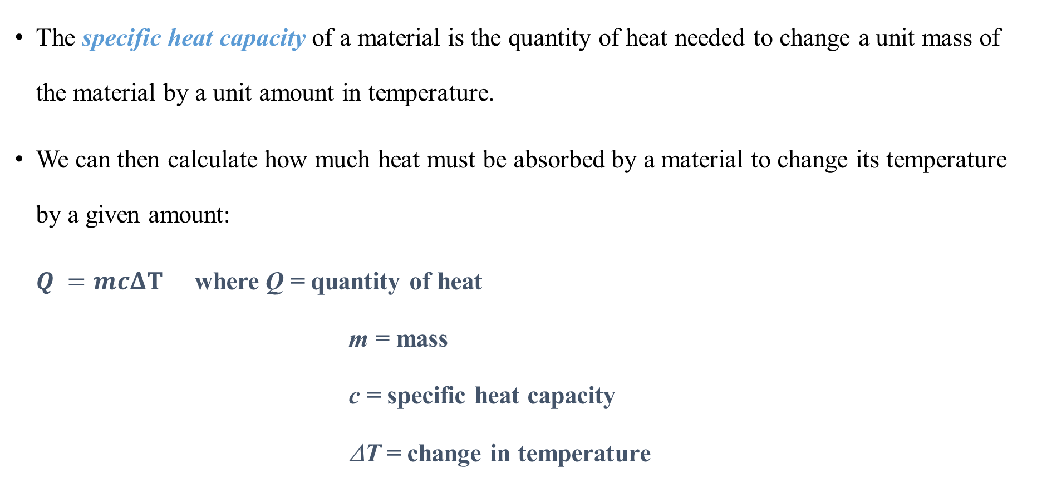
Specific Heat and Latent Heat (Cont’d)
The specific heat capacity of a material is the quantity of heat needed to change a unit mass of the material by a unit amount in temperature.
We can then calculate how much heat must be absorbed by a material to change its temperature by a given amount:
$Q =mcΔT$ where Q = quantity of heat
m = mass
c = specific heat capacity
ΔT = change in temperature
ASTU
Specific Heat and Latent Heat - 16/49
June - 2022

Slide 17
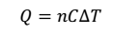
Specific Heat and Latent Heat (Cont’d)
The amount of heat required to change the temperature of n moles of a substance, usually for gases, by ΔT is :
The heat capacity (C) is defined as the amount of heat energy required to raise the temperature of a substance by 1⁰C
ASTU
Specific Heat and Latent Heat - 17/49
June - 2022

Slide 18
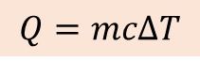
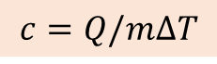
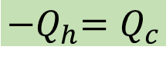
Specific Heat and Latent Heat (Cont’d)
$$c=Q/m∆T$$
The quantity of heat energy ($Q$) required to raise a temperature of a substance.
$$Q=mc∆T$$
Heat energy can flow from hot region (substance) to cold region (substance).
$${−Q}_{h}=Q_{c}$$
Hot substance lose its ($∆T=−ve$) heat energy whereas cold substance gain heat energy ($∆T=+ve$) from hot substance.
$Heat energy lost by hotter body=Heat energy gained by colder body$
ASTU
Specific Heat and Latent Heat - 18/49
June - 2022

Slide 19
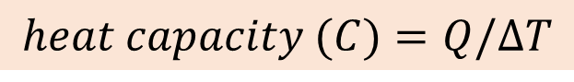
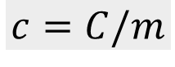
Specific Heat and Latent Heat (Cont’d)
$Heat energy lost by hotter body=Heat energy gained by colder body$
The heat capacity ($C$) of a body is the defined as the energy required to raise the temperature of given body by $1 K;$ the mass of the body is not considered.
$$heat capacity (C)=Q/∆T$$
$$specific heat capacity=heat capacity/mass$$
$$c=C/m$$
ASTU
Specific Heat and Latent Heat - 19/49
June - 2022

Slide 20
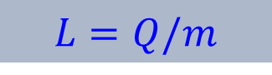
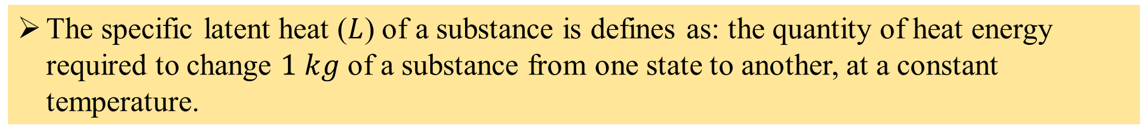

Specific Heat and Latent Heat (Cont’d)
If solid and liquid get heat energy, their particles gain energy and begin to vibrate faster and move further apart as its temperature increases. This continues until the solid melts and liquid boils.
The specific latent heat ($L$) of a substance is defines as: the quantity of heat energy required to change $1 kg$ of a substance from one state to another, at a constant temperature.
$$L=Q/m$$
$$Q=mL$$
There are two changes of state to consider, solid to liquid and liquid to gas.
We use two different versions of latent heat, the latent heat of fusion (melting) ($L_{f}$) and latent heat of vaporization (boiling) ($L_{v}$).
ASTU
Specific Heat and Latent Heat - 20/49
June - 2022

Slide 21
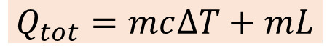
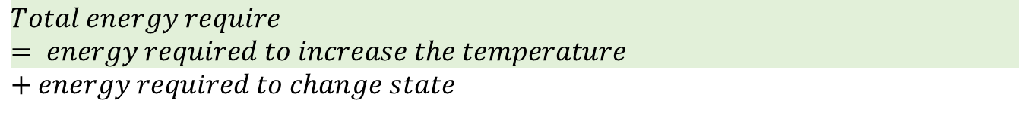
Specific Heat and Latent Heat (Cont’d)
Specific latent heat of fusion ($L_{f}$) is the quantity of heat energy required to change $1 kg$of a substance from solid to liquid at a constant temperature.
Specific latent heat of vaporization ($L_{v}$) is the quantity of heat energy required to change $1 kg$of a substance from liquid to gas at a constant temperature.
Now we use specific heat capacities and specific latent heats, to calculate the total energy required to change the state and raise the temperature$.$
$$Total energy require= energy required to increase the temperature+energy required to change state$$
$$Q_{tot}=mc∆T+mL$$
ASTU
Specific Heat and Latent Heat - 21/49
June - 2022

Slide 22
Phase Changes and Latent Heat
Specific Heat and Latent Heat (Cont’d)
When an object goes through a change of phase or state, heat is added or removed without changing the temperature. Instead, the state of matter changes: for eg. solid to liquid
The amount of heat needed per unit mass to produce a phase change is called the latent heat.
The latent heat of fusion of water corresponds to the amount of heat needed to melt one gram of ice.
The latent heat of vaporization of water corresponds to the amount of heat needed to turn one gram of water into steam.
ASTU
Specific Heat and Latent Heat - 22/49
June - 2022

Slide 23
Example: If the specific heat capacity of ice is 0.5 cal/g⋅C°, how much heat would have to be added to 200 g of ice, initially at a temperature of -10°C, to raise the ice to the melting point?
Specific Heat and Latent Heat (Cont’d)
m = 200 g
c = 0.5 cal/g⋅C°
T = -10°C
Q = mcΔT
= (200 g)(0.5 cal/g⋅C°)(10°C) = 1,000 cal
(heat required to raise the temperature)
ASTU
Specific Heat and Latent Heat - 23/49
June - 2022

Slide 24
Example: If the specific heat capacity of ice is 0.5 cal/g⋅C°, how much heat would have to be added to 200 g of ice, initially at a temperature of -10°C, to completely melt the ice? (Latent heat is 80 cal/g)
Specific Heat and Latent Heat (Cont’d)
L_{f} = 80 cal/g Q = mL_{f}
= (200 g)(80 cal/g) = 16,000 cal
(heat required to melt the ice)
Total heat required to raise the ice to 0 °C and then to melt the ice is:
1,000 cal + 16,000 cal = 17,000 cal = 17 kcal
ASTU
Specific Heat and Latent Heat - 24/49
June - 2022

Slide 25
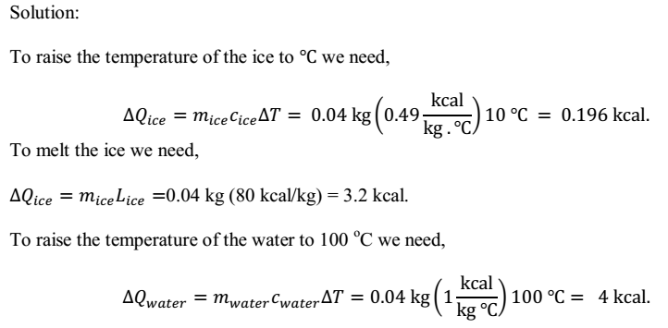
Specific Heat and Latent Heat (Cont’d)
Example: How much heat energy is required to change a 40 g ice cube from a solid at -10 ⁰C to steam at 110 ⁰C?
ASTU
Specific Heat and Latent Heat - 25/49
June - 2022

Slide 26
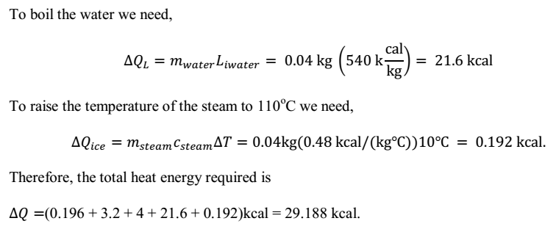
Specific Heat and Latent Heat (Cont’d)
ASTU
Specific Heat and Latent Heat - 26/49
June - 2022

Slide 27

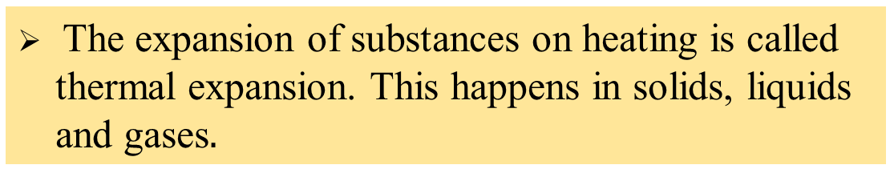
A Review of Thermal Expansion of Solids and Liquids
As the particles gain more energy, we can see that they move further apart from each other, which means the substance will expand.
The expansion of substances on heating is called thermal expansion. This happens in solids, liquids and gases$.$
In thermal equilibrium the heat loss from hot substance is equal to heat gained by cold substance, so that there is no net movement of energy between two substances.
If two bodies are in thermal equilibrium, they will also be at the same temperature.
ASTU
A Review Thermal Expansion of Solids and Liquids - 27/49
June - 2022

Slide 28
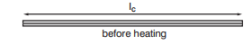
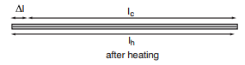


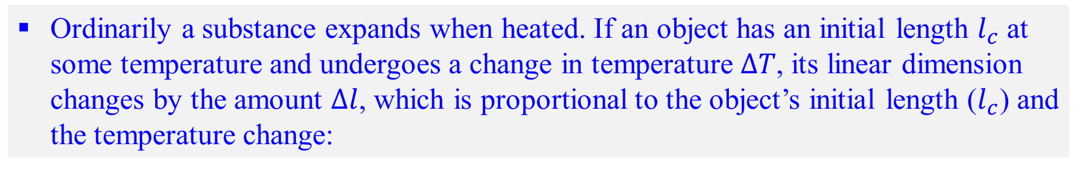
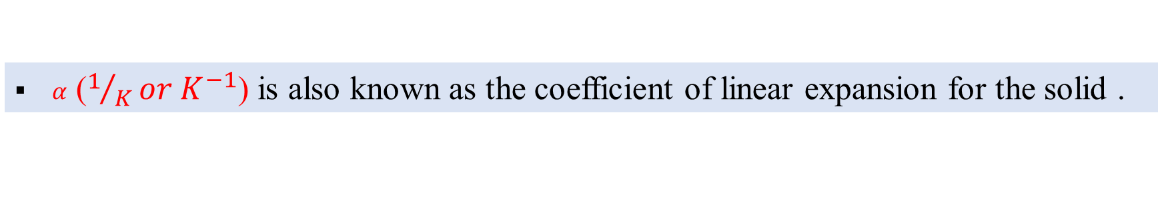

A Review of Thermal Expansion (cont’d…)
Ordinarily a substance expands when heated. If an object has an initial length $l_{c}$ at some temperature and undergoes a change in temperature $∆T$, its linear dimension changes by the amount $∆l$, which is proportional to the object’s initial length ($l_{c}$) and the temperature change:
$$∆l=αl_{c}∆T$$
$$∆l=l_{h}−l_{c}$$
$$l_{h}=l_{c}(1+α∆T)$$
$α$ ($1/Kor K^{−1}$) is also known as the coefficient of linear expansion for the solid .
ASTU
A Review of Thermal Expansion (cont’d…) - 28/49
June - 2022

Slide 29
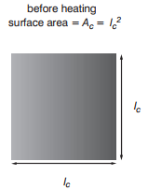
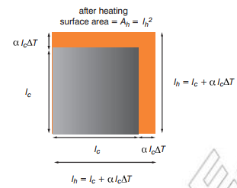
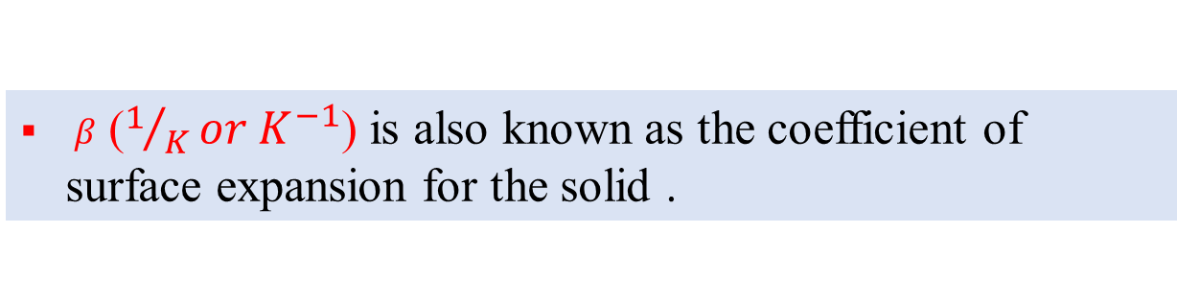


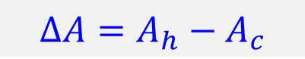
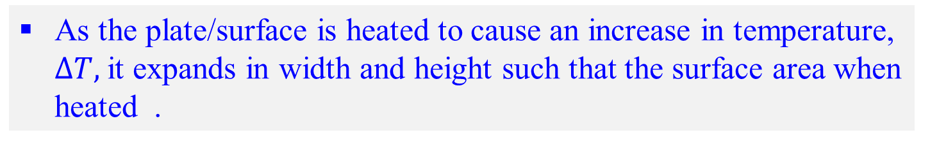
A Review of Thermal Expansion (cont’d…)
As the plate/surface is heated to cause an increase in temperature, $∆T,$it expands in width and height such that the surface area when heated .
$$∆A=A_{h}−A_{c}$$
$$∆A=βA_{c}∆T$$
$$A_{h}=A_{c}(1+β∆T)$$
$β$ ($1/Kor K^{−1}$) is also known as the coefficient of surface expansion for the solid .
ASTU
A Review of Thermal Expansion (cont’d…)- 29/49
June - 2022

Slide 30
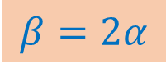
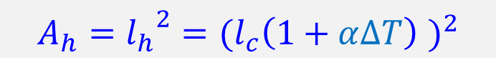
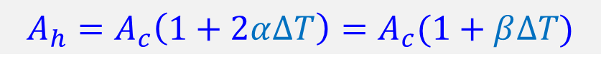

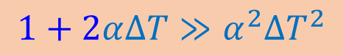
A Review of Thermal Expansion (cont’d…)
$$A_{h}={l_{h}}^{2}={(l_{c}\left(1+α∆T\right) )}^{2}$$
$$A_{h}={l_{h}}^{2}={l_{c}}^{2}(1+2α∆T+α^{2}{∆T}^{2})$$
$$1+2α∆T≫α^{2}{∆T}^{2}$$
$$A_{h}=A_{c}(1+2α∆T)$$
Therefore,
$$A_{h}=A_{c}\left(1+2α∆T\right)=A_{c}(1+β∆T)$$
$$β=2α$$
ASTU
A Review of Thermal Expansion (cont’d…)- 30/49
June - 2022

Slide 31
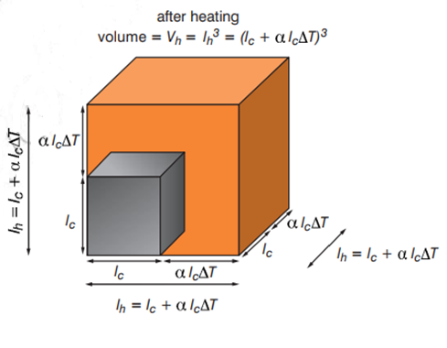
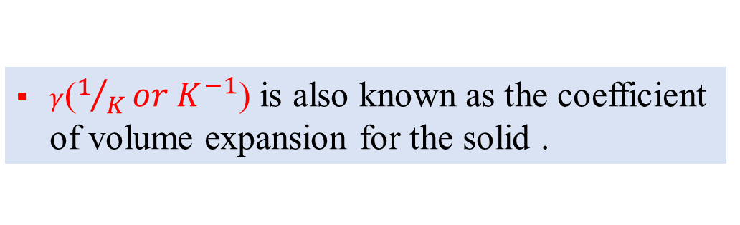



A Review of Thermal Expansion (cont’d…)
Consider the expansion of cube.
$$∆V=V_{h}−V_{c}$$
$$∆V=γV_{c}∆T$$
$$V_{h}=V_{c}(1+γ∆T)$$
$γ$($1/Kor K^{−1}$) is also known as the coefficient of volume expansion for the solid .
ASTU
A Review of Thermal Expansion (cont’d…)- 31/49
June - 2022

Slide 32
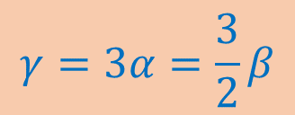

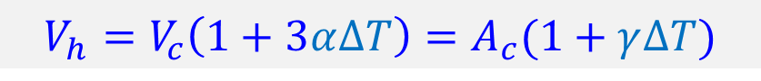

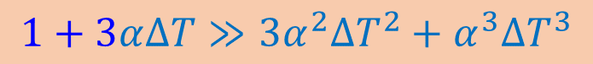
A Review of Thermal Expansion (cont’d…)
$$V_{h}={l_{h}}^{3}={(l_{c}\left(1+α∆T\right) )}^{3}$$
$$V_{h}={l_{h}}^{3}={l_{c}}^{3}\left(1+3α∆T+{3α}^{2}{∆T}^{2}+α^{3}{∆T}^{3}\right)$$
$$1+3α∆T≫{3α}^{2}{∆T}^{2}+α^{3}{∆T}^{3}$$
$$V_{h}=V_{c}(1+3α∆T)$$
Therefore,
$$V_{h}=V_{c}\left(1+3α∆T\right)=A_{c}(1+γ∆T)$$
$$γ=3α=\frac{3}{2}β$$
ASTU
A Review of Thermal Expansion (cont’d…)- 32/49
June - 2022

Slide 33
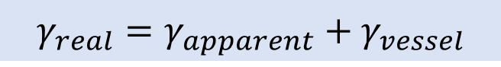
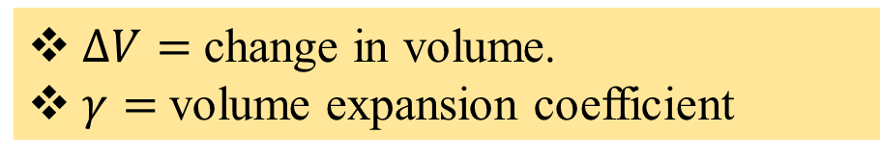
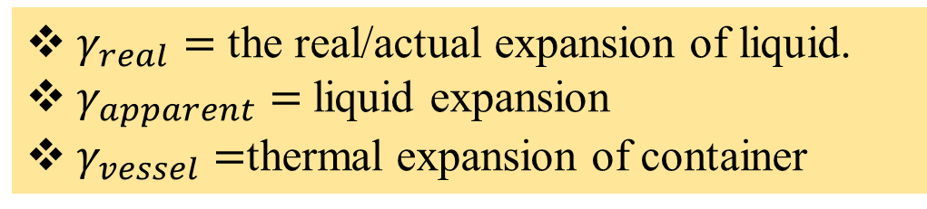

A Review of Thermal Expansion (cont’d…)
Volume expansion of liquid;
$$∆V=γV_{c}∆T$$
$∆V=$ change in volume.
$γ=$volume expansion coefficient
$$γ_{real}=γ_{apparent}+γ_{vessel}$$
$γ_{real}=$ the real/actual expansion of liquid.
$γ_{apparent}=$liquid expansion
$γ_{vessel}=$thermal expansion of container
ASTU
A Review of Thermal Expansion (cont’d…)- 33/49
June - 2022

Slide 34
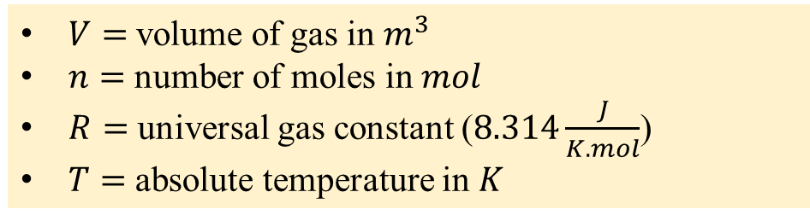



A Review of Thermal Expansion (cont’d…)
The volume expansion of gas is affected factors;
Pressure ($P$)
The amount (number of moles) of gas present ($n$)
Temperature ($T$)
$$PV=nRT$$
$V=$volume of gas in $m^{3}$
$n=$ number of moles in $mol$
$R=$ universal gas constant ($8.314\frac{J}{K.mol}$)
$T=$ absolute temperature in $K$
At fixed/constant pressure and amount of gas, $V∝T$.
$$γ_{solid}<γ_{liquid}<γ_{gas}$$
ASTU
A Review of Thermal Expansion (cont’d…)- 34/49
June - 2022

Slide 35


Heat Transfer Mechanisms
Heat may be transferred from one place to another in three ways: ➢ conduction ➢ convection ➢ radiation ➢ direct burning
ASTU
Heat Transfer Mechanisms - 35/49
June - 2022

Slide 36




Heat Transfer (cont’d)
Conduction
Conduction is the flow of heat directly through a physical material
The amount of heat Q that flows through a rod:
increases proportionally to the cross-sectional area A
increases proportionally to ΔT from one end to the other
increases steadily with time
decreases inversely with the length of the rod
The constant k is called the thermal conductivity of the material
ASTU
Heat Transfer Mechanisms - 36/49
June - 2022

Slide 37




Heat Transfer (cont’d)
The process of energy transfer by heat can also be called conduction or thermal conduction.
Conduction occurs only if there is a difference in temperature between two parts of the conducting medium.
The energy $Q$ transfers in a time interval $∆t$ from the hotter face to the colder one.
This means that the rate of flow of heat ($P$) energy $Q/t$ in watts (J/s) along the bar will be given by:
$$P=\frac{Q}{t}=kA\frac{∆T}{∆x}=kA\frac{T_{h}−T_{c}}{∆x}$$
ASTU
Heat Transfer (cont’d)- 37/49
June - 2022

Slide 38

Heat Transfer (cont’d)
The constant $k (\frac{W}{m.k})$ depends on which material the bar is made from. It is known as the material’s thermal conductivity.
Thermal conductivity a measurement of the ability of a material to conduct heat.
ASTU
Heat Transfer (cont’d) - 38/49
June - 2022

Slide 39




Heat Transfer (cont’d)
Convection
Convection is the flow of fluid due to a difference in temperatures, such as warm air rising. The fluid “carries” the heat with it as it moves.
ASTU
Heat Transfer Mechanisms - 39/49
June - 2022

Slide 40




Heat Transfer (cont’d)
Radiation
All objects give off energy in the form of radiation, as electromagnetic waves (light) – infrared, visible light, ultraviolet – which, unlike conduction and convection, can transport heat through a vacuum.
Objects that are hot enough will glow – first red, then yellow, white, and blue.
ASTU
Heat Transfer Mechanisms - 40/49
June - 2022

Slide 41
Radiation
Heat Transfer (cont’d)
Objects tends to absorb electromagnetic waves from their surroundings
An ideal absorber is called a blackbody, an ideal reflector is called a white body
Objects tend to radiate electromagnetic waves as efficiently as they absorb them
The transfer of energy through the emission of EM waves is called radiation
ASTU
Heat Transfer Mechanisms - 41/49
June - 2022

Slide 42
Transfer of Heat Energy
Heat involves a transfer of internal energy from one location to another.
Internal energy is the energy associated with the atoms and molecules of the system.
The internal energy includes kinetic and potential energy associated with the random translational, rotational, and vibrational motion of the particles that make up the system, and any potential energy bonding the particles together.
Heat is the transfer of energy between a system and its environment due to a temperature difference between them.
Temperature is a quantitative measurement of object’s relative the degree of hotness and coldness.
ASTU
Transfer of Heat Energy - 42/49
June - 2022

Slide 43
Transfer of Heat (cont’d)
When these energy waves fall on a body, the energy may be:
Absorbed
Transmitted
Reflected
ASTU
Transfer of Heat (cont’d)- 43/49
June - 2022

Slide 44

1st Law of Thermodynamics
The first law of thermodynamics states that: “The change in internal energy of a system is equal to the sum of the heat flow into the system and the work done on the system.”
The total increase in the thermal energy of a system is the sum of the work done on it and the heat added to it.
$$ΔU=W+Q$$
ΔU = change in the thermal energy of the system
W = work done on the system (W = PΔV = F.d or W=ΔK)
Q = heat added to the system ; (Q is + if absorbed, Q is – if released)
The First Law for different thermodynamic systems:
Isolated system-is a system which does not exchange heat with its surrounding and no work is done on the external environment.
ASTU
1st Law of Thermodynamics - 44/49
June - 2022

Slide 45


1st Law of Thermodynamics
In this case $Q=0$ and $W=0$, so from the first law we conclude
$$ΔU = 0$$
or, U is constant, The internal energy of an isolated system is constant.
Cyclic Process
Engines operate in cycles, in which the system –for example, a gas-periodically returns to its initial state. Since the system returns to its initial state, the change in internal energy in one complete cycle is zero; that is, $ΔU=0$ From the first law we see that
$$Q = W$$
ASTU
1st Law of Thermodynamics - 45/49
June - 2022

Slide 46


1st Law of Thermodynamics
Isochoric process In a constant volume process, the volume of the system stays constant. Consequently, $W= 0$. From the first law we see that All the heat entering the system goes into increasing the internal energy. $$ΔU = Q$$
Adiabatic Process In an adiabatic process, the system does not exchange heat with its surroundings; that is, Q = 0. The first law for an adiabatic process takes the form
$$ΔU = W$$
ASTU
1st Law of Thermodynamics - 46/49
June - 2022

Slide 47


1st Law of Thermodynamics
Isothermal Process It is a process which involves no change in the temperature of the system. If the process occurs at constant temperature then there is no change in the internal energy of the system so . The first law for an isothermal process takes the form
For an ideal gas in isothermal process the work done is calculated as
ASTU
1st Law of Thermodynamics - 47/49
June - 2022

Slide 48

1st Law of Thermodynamics
Isobaric process In an isobaric process the expansion or compression occurs at constant pressure. Any work done by the system will result in an increase in volume. The work done in Pressure- Volume graph is equal to the area under the PV graph. For an isobaric process the work done W is calculated as
$$W=−P∆V=−P(V_{f}−V_{i})$$ The first law for an isobaric process can be written as
ASTU
1st Law of Thermodynamics - 48/49
June - 2022

Slide 49
End
The End
ASTU
End – 49/49
June - 2022

